Slide 1
Team Cookie Council
Girl Scout Badge Tracking Application
For The Girl Scouts of America
Matt, 1

Slide 2
Team Roles
Scrum Master
Ryan Schroeder
Customer Proxy
Nate Martz
Quality Assurance
Mike Glosecki
Database Architect
Matt Eck
Customer Representative
Jennifer Melton
Matt, 2

Slide 3
Project Introduction
Purpose:
Replace the paper documentation system currently used by Girl Scout leaders.
Functions:
Badge Tracking, Financial Tracking, Event Tracking, and Shopping List Creation.
Proposed System:
Web page, iOS & Android mobile application
Matt, 3

Slide 4
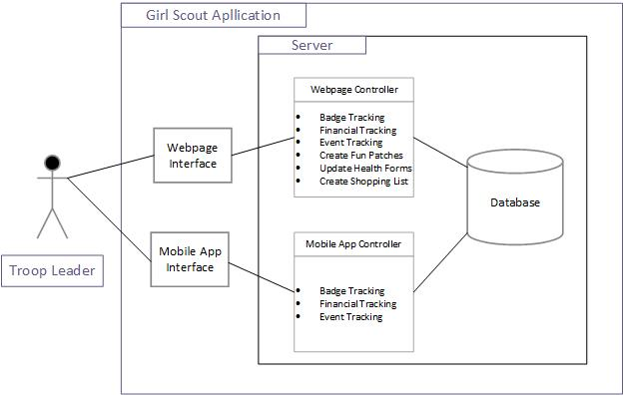
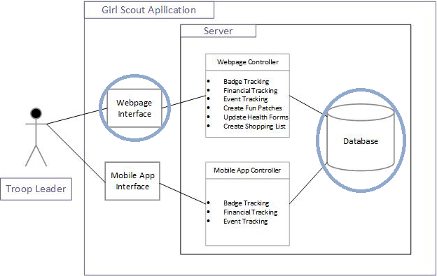
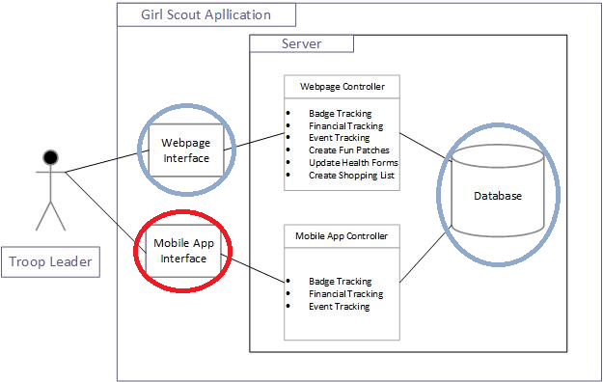
Proposed Architecture
Database
Stores records
Webpage Interface
Updates and displays all current records
Mobile Interface
iOS application that updates and displays records
Nate, 4

Slide 5
Project Management and Risks
Bi-weekly Standup meetings
Briefly discuss risks and team member progress
Constant contact with team members using google hangouts application and Email updates to client
Mobile Application Development
Meeting with Socratis Toraritis
No access to a web server
Using WAMP to host the database locally
Nate, 5

Slide 6
Quality Assessment and Testing
Behavior Driven Design testing from scenarios
Input Validation for correctness of functions and data
First using dummy data, then real data
Maintenance Instructions and meaningful error reports
Nate, 6

Slide 7
CS425 Exit Strategy
Useable web interface for record keeping
Completion of an iOS prototype that can connect to the database
Client Feedback Analysis of prototypes
Nate, 7

Slide 8
Efforts
Matt & Ryan
Database
MYSQL
ERD
Mobile research
Meeting with Socratis Tornaritis
Ryan, 8

Slide 9
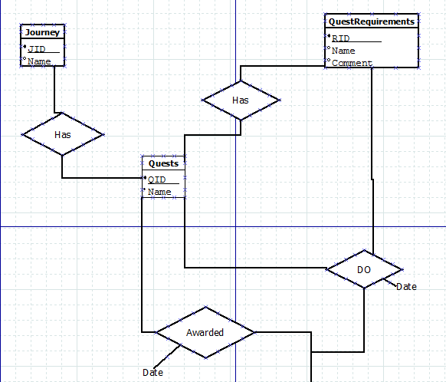
ERD
Ryan, 9

Slide 10
Efforts Cont.
Mike & Nate
Web Development
HTML
CSS
Jquery
PHP
Ryan, 10

Slide 11
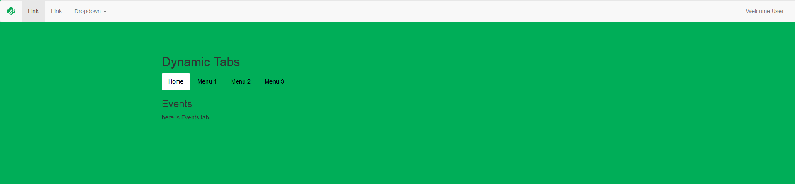
Web Page Template
Ryan, 11

Slide 12
CS425 Exit Strategy
All goals were achieved.
Core components:
Basic, functional web application
Simple iOS app
Complete database
Mike, 12

Slide 13
Post Mortem
Good:
Strong team dynamics
High levels of effort
Bad:
Version control and use of BitBucket
Uneven levels of effort
Mike, 13

Slide 14
Plans for Next Semester
Refinement of basic web pages with database interactions
Completion of Android and iOS mobile applications
Matt, 14

